Slide 1
CS 172 Project: dungeon exploration game
By Samuel Wynsma
Derek Price
Cyruz Campos

Slide 2

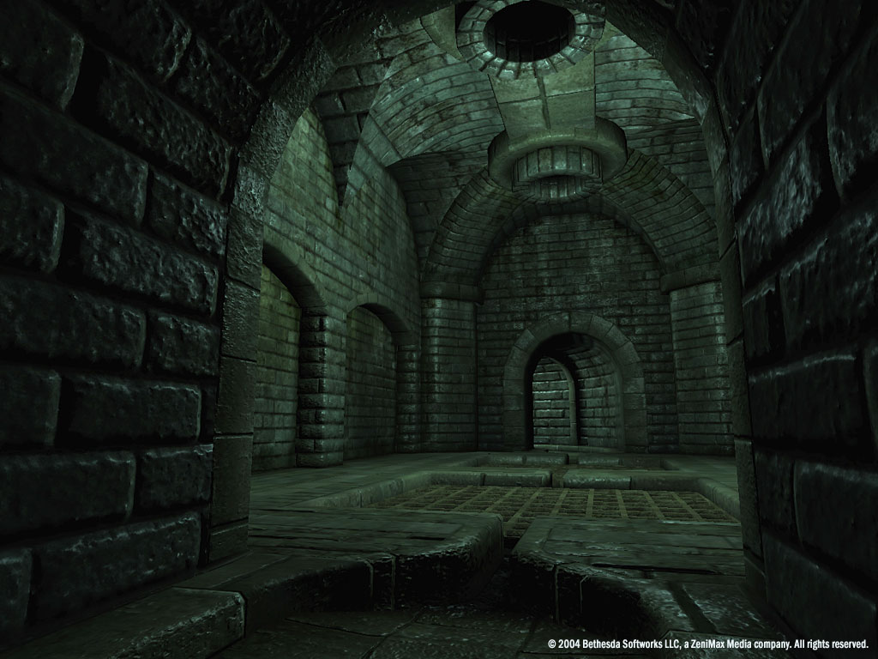
Problem definition
Our goal was to make a playable (and fun) dungeon exploration game.
Part of our goal was to design a procedurally generated dungeon to explore.

Slide 3

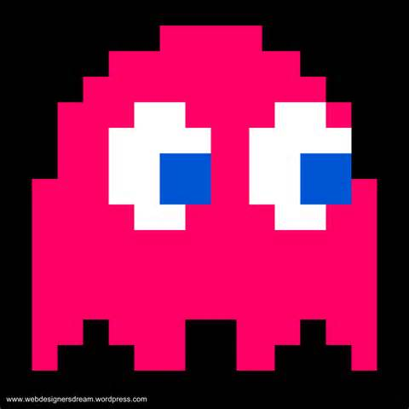


Requirements
The game needed to have randomly generated rooms.
The player needed to be able to move within and between rooms.
The game needed to have monsters to defeat and items to use and pick up.

Slide 4
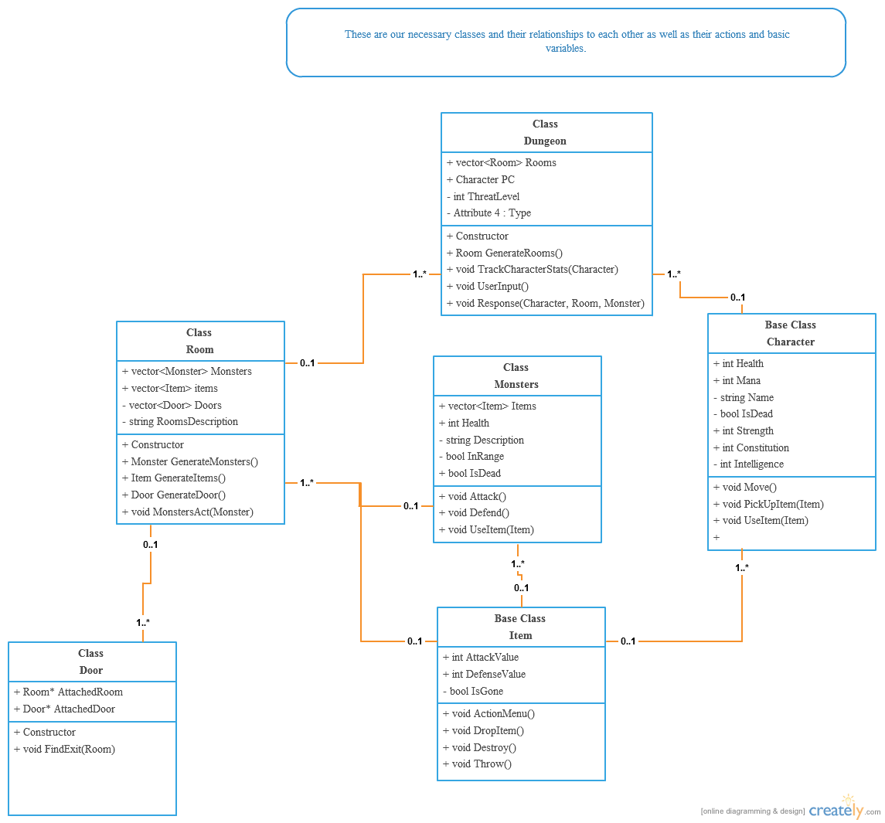
Original UML Diagram

Slide 5
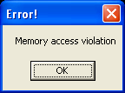

Challenges
The biggest challenge were issues with dependency and access.
The program had a very complicated object structure.
We had an issue with circular dependency.
Artificial intelligence.
File input issues.
Where to place certain functions.

Slide 6
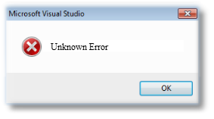
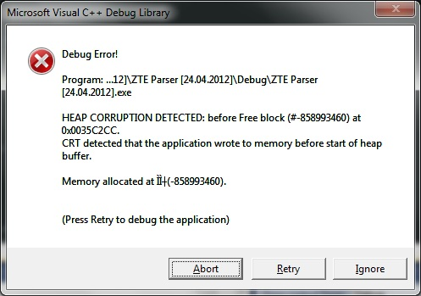

Other Challenges
The weird crashes (heap corruption).
The unidentifiable errors (many vector subscript out of range issues).
The number of vectors in play.

Slide 7

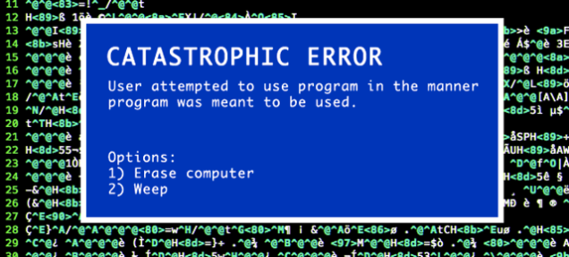
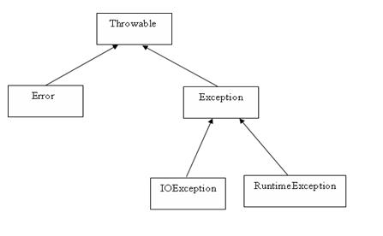
General solution approach
We brute-forced our way through many of our problems.
In class we discussed particularly bad issues.
We used lots of vectors and moved our code around many times.
We changed our code greatly from our original intent.
Lack of exception handling.

Slide 8
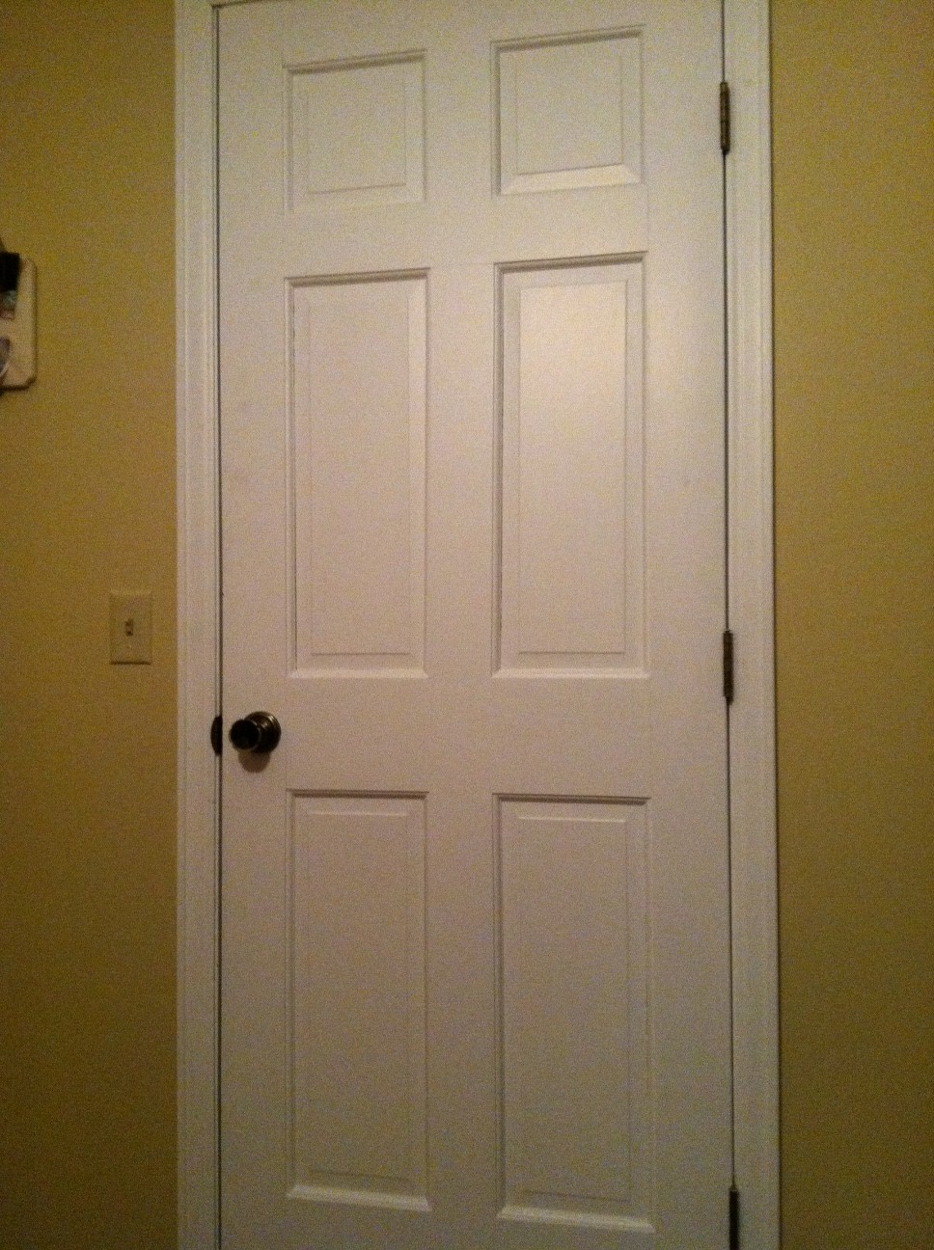
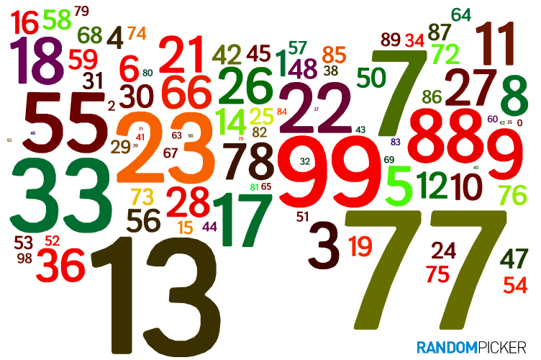
The “Cool” Factor
The Program generates a completely random dungeon as the player goes.
The doors can lead anywhere.
The items are randomly assigned and are drawn from a file.
The number of doors, items, and monsters is also semi-random.
The monsters move toward the player.

